Slide 1
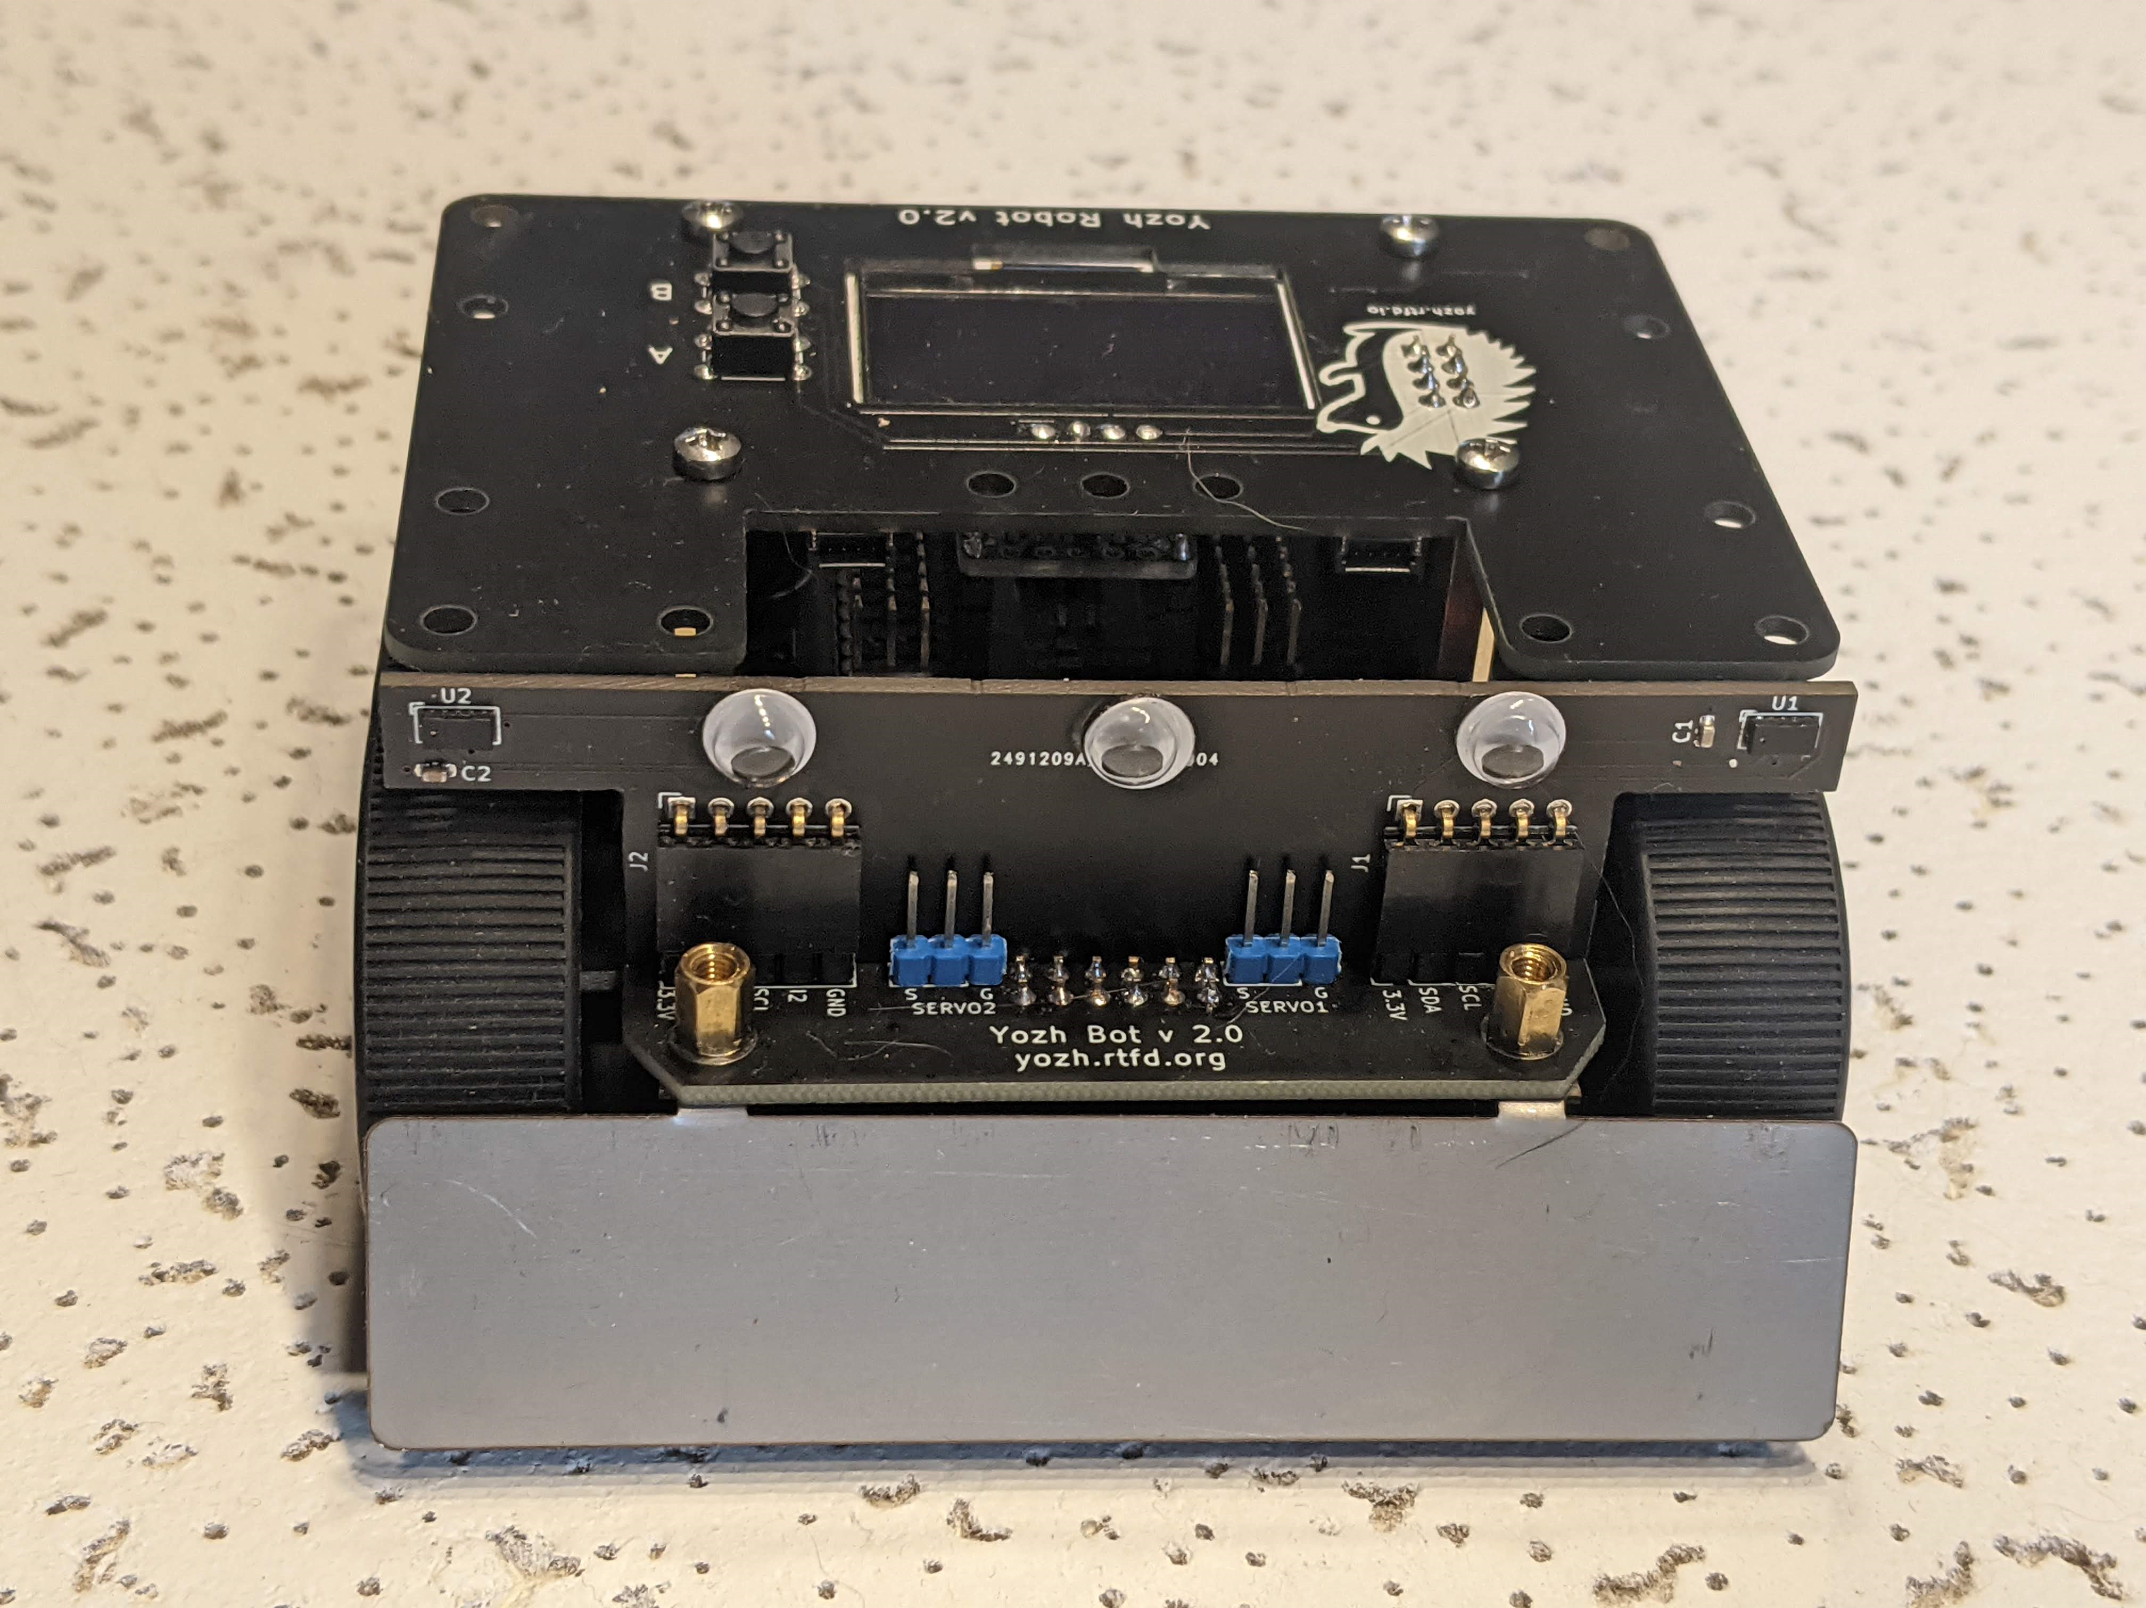
Distance sensors

Slide 2
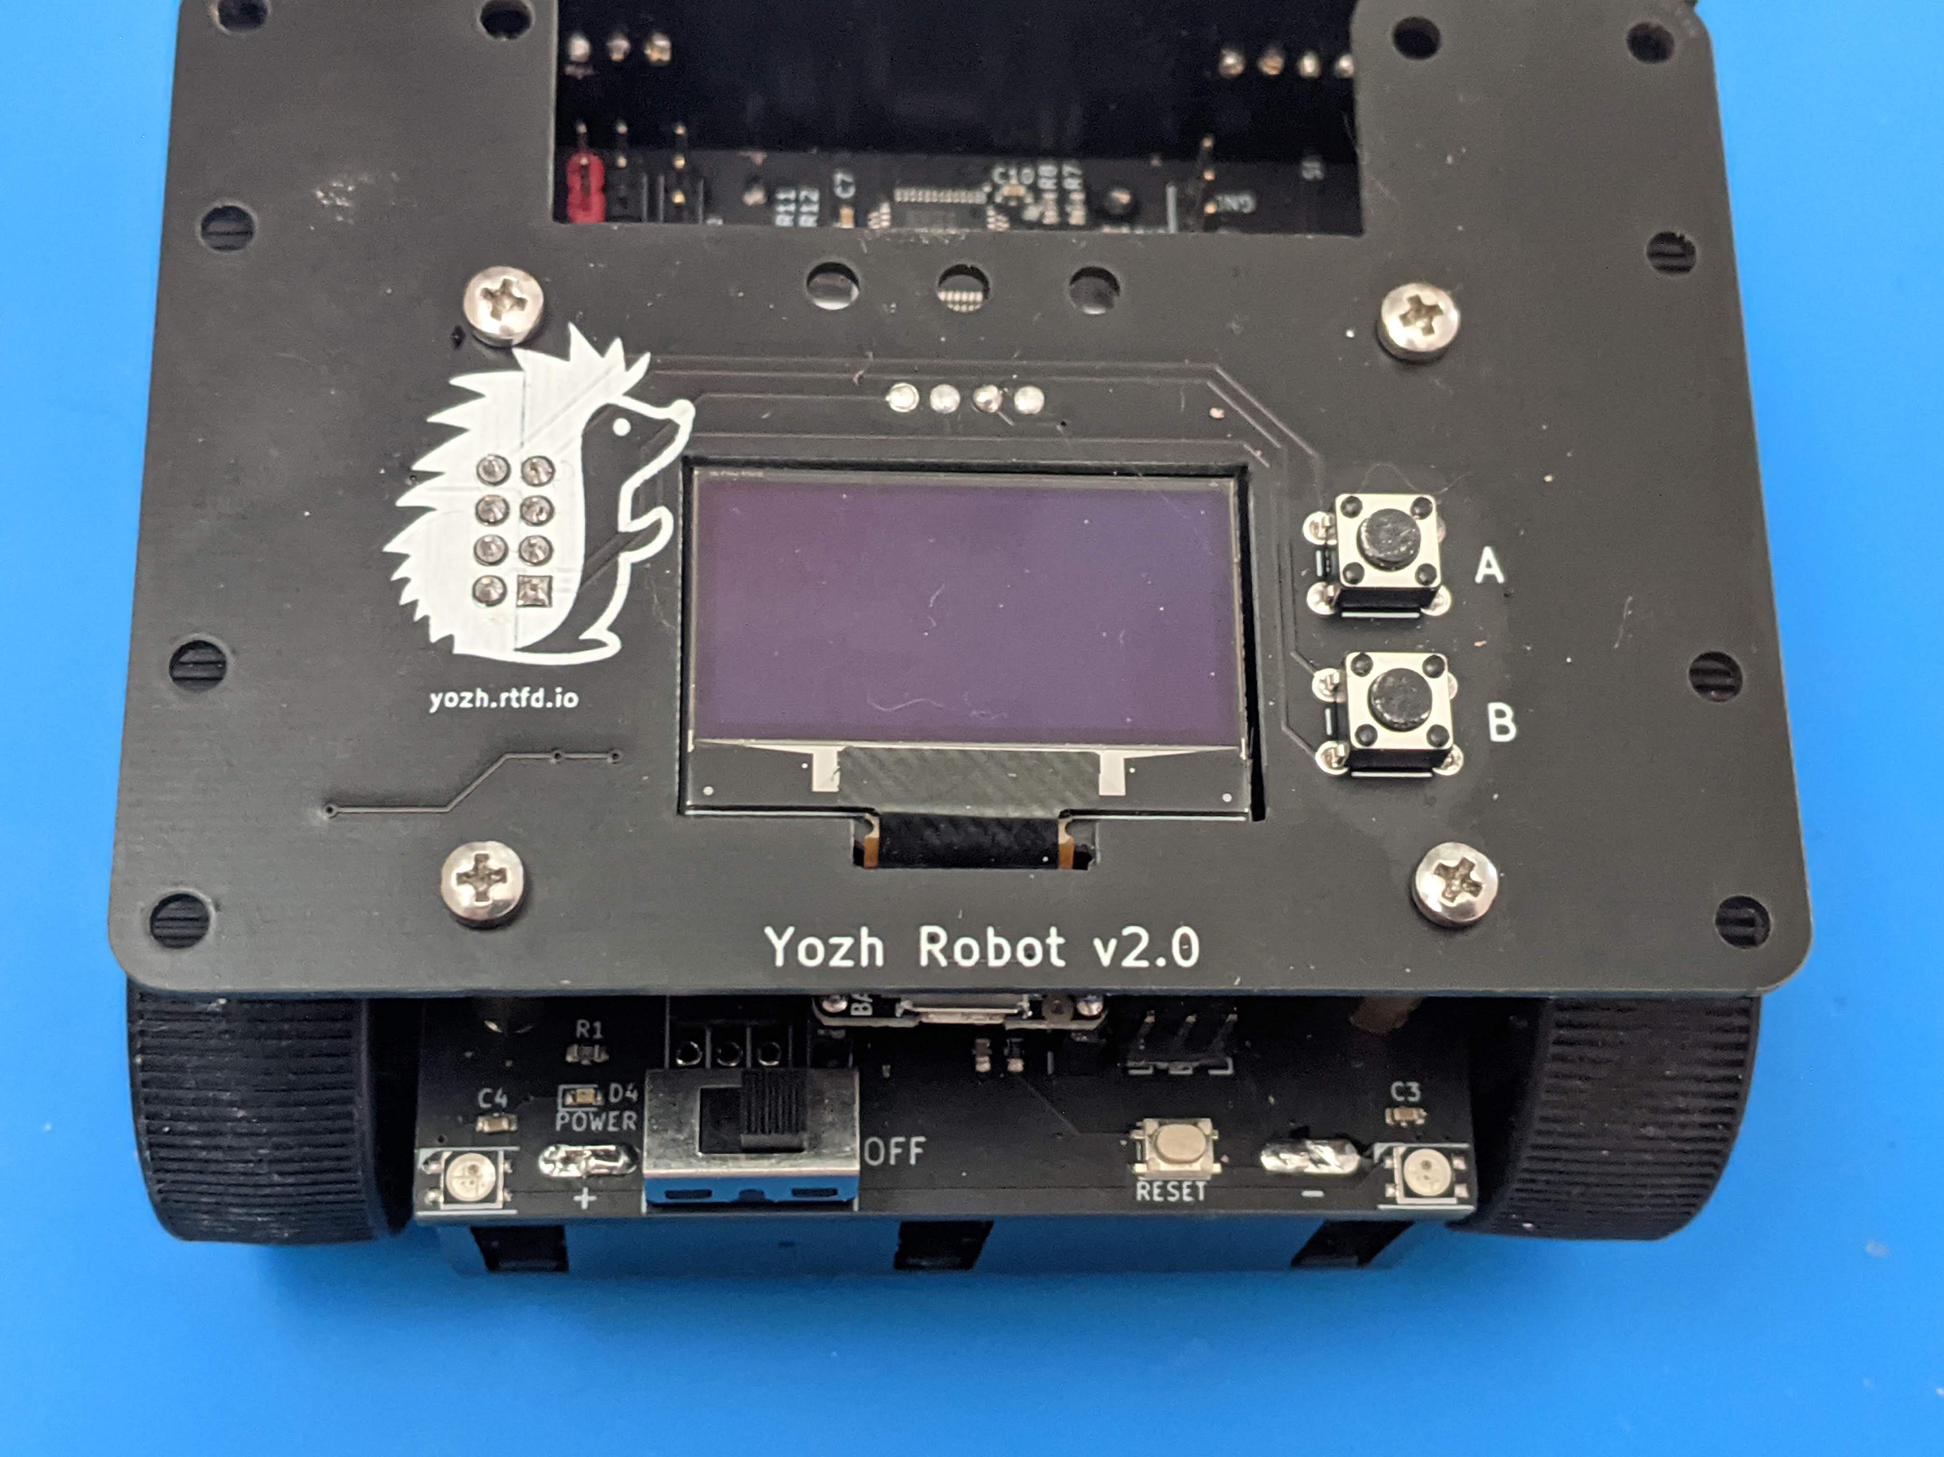
User buttons
OLED screen
NeoPixel LEDs
Power Indicator
Power switch
Reset button

Slide 3
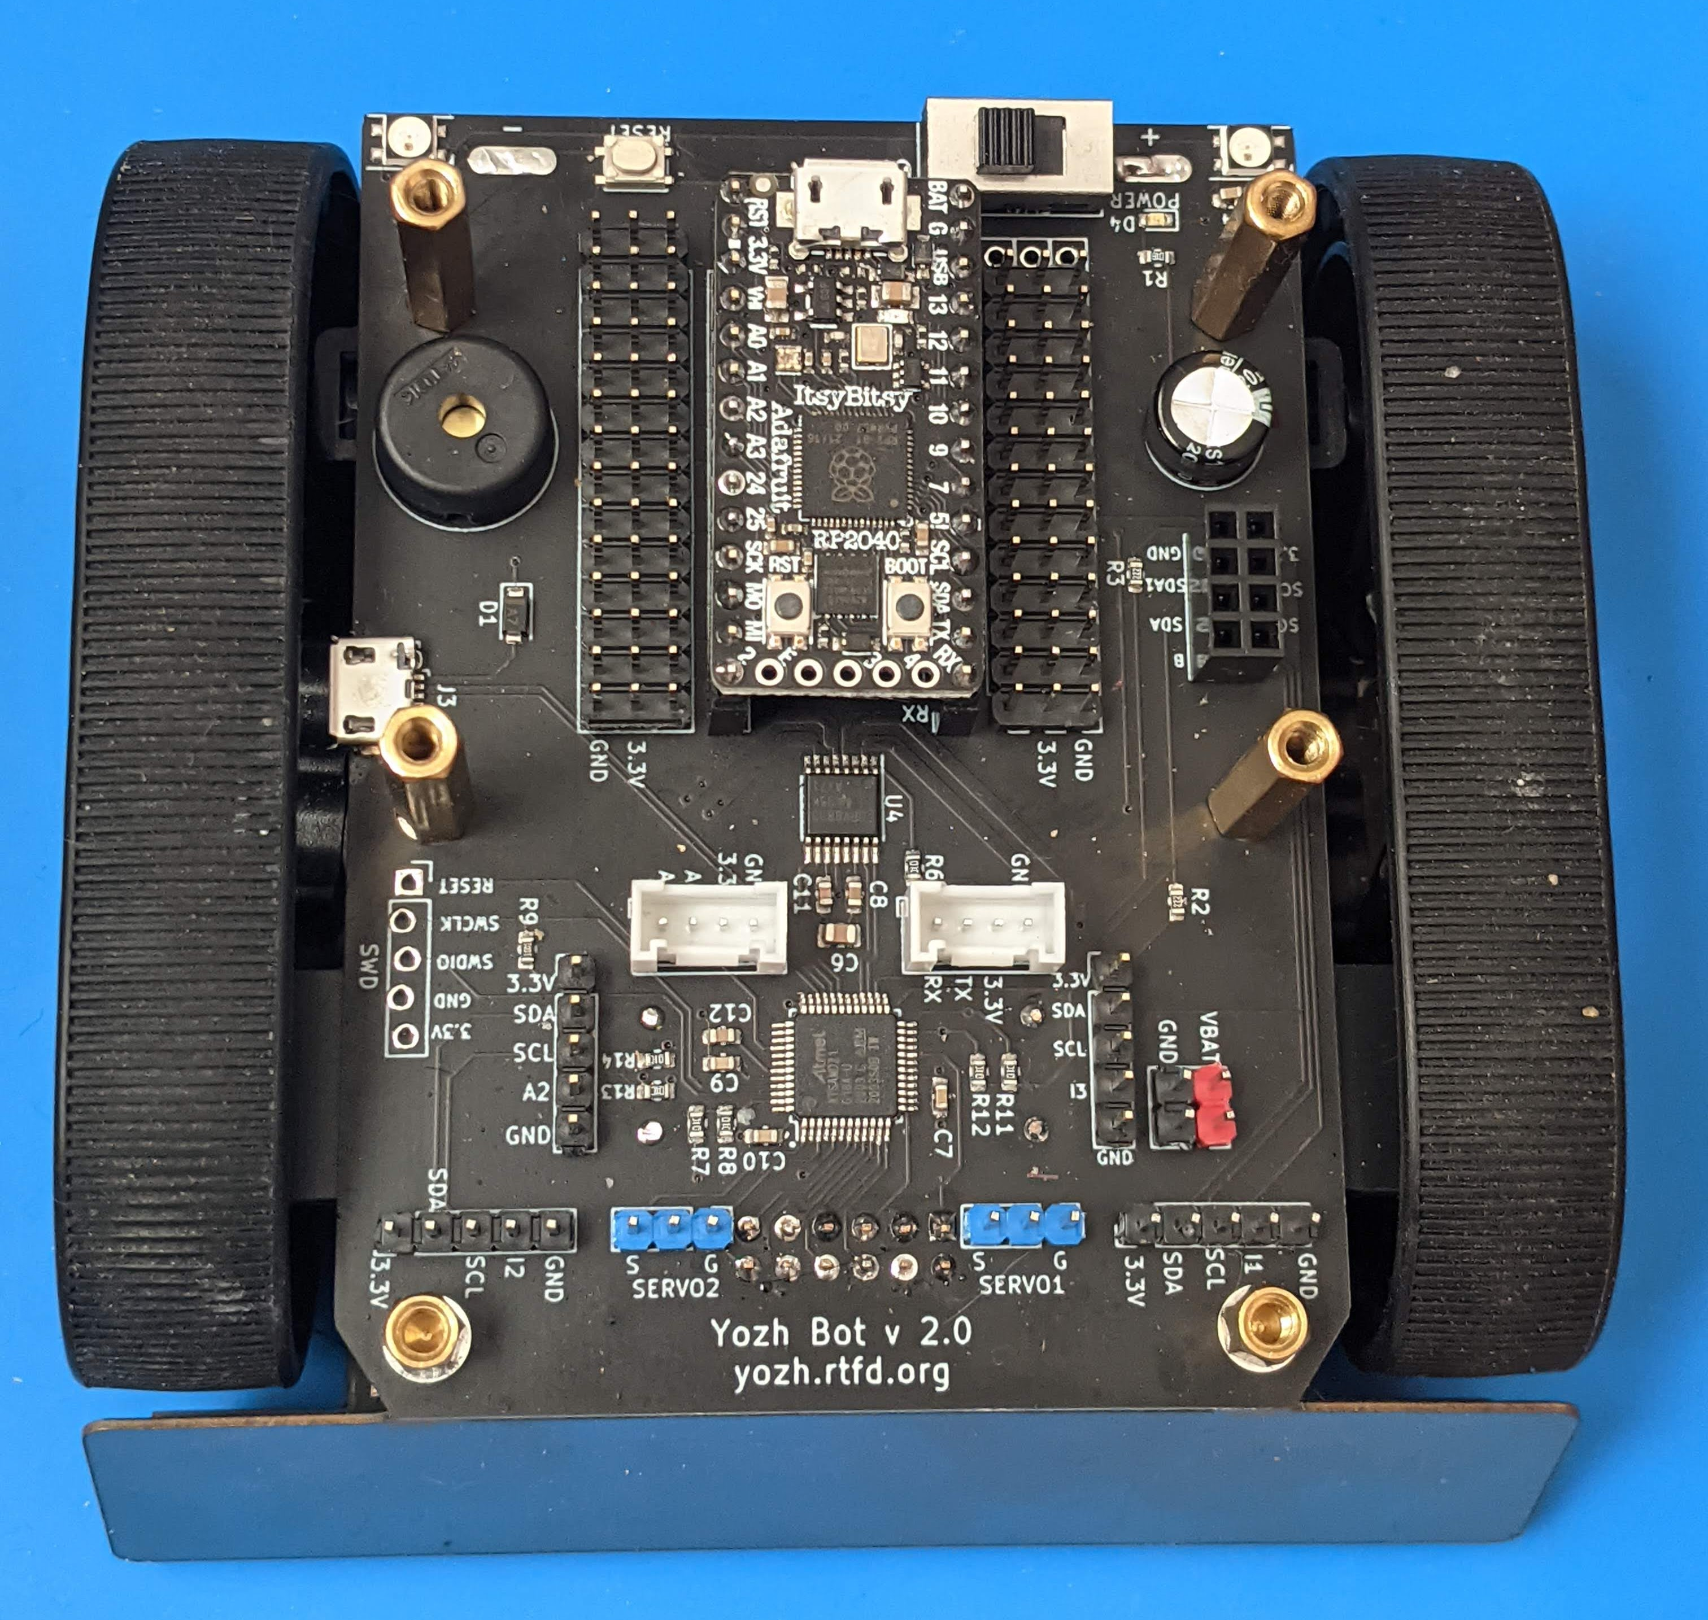
ItsyBitsy RP2040
BUZZER
SAMD21 USB
DRV8833 Motor driver
SAMD21 MCU

Slide 4
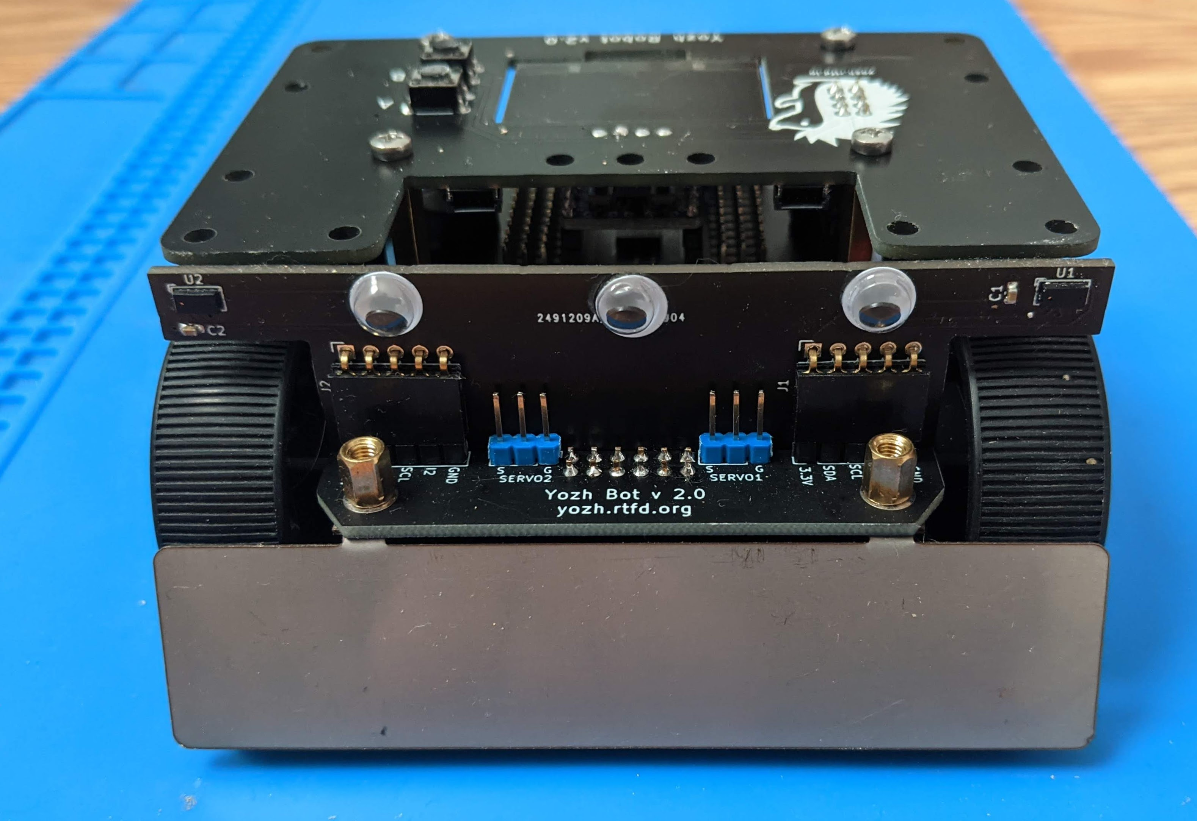
Distance sensors
Reflectance array (behind blade)
Blade

